Slide 1

Computational Drug Repositioning using Knowledge Graph and AI
Team Members
Om Gupta 21ucs140
Pitani Nitin Srichakri 21ucs149
Tarun Agarwal 21ucs219
Guided by
Dr. Abhijit Adhikari
Co-guided by
Dr. Poulami Dalapati

Slide 2
Table of Contents
Introduction
Motivation
Some Definitions
Literature Survey
Objective

Slide 3
Introduction
What is Drug Discovery ?
Drug discovery is the process by which new medications are identified and developed.
What are stages of drug discovery ?
Identification of a target
Lead compound development
Preclinical and clinical testing
Target Discovery
Target Validation
Lead Optimization
Development
Trials
Notes:
Identification of a target: Researchers identify a biological target, such as a protein or pathway, that plays a crucial role in a disease.
Lead compound development: Molecules (lead compounds) are identified or designed to interact with the target and potentially modulate its activity.
Preclinical and clinical testing: Promising lead compounds undergo rigorous testing in laboratory and animal models (preclinical) before advancing to human clinical trials to evaluate safety and efficacy.

Slide 4
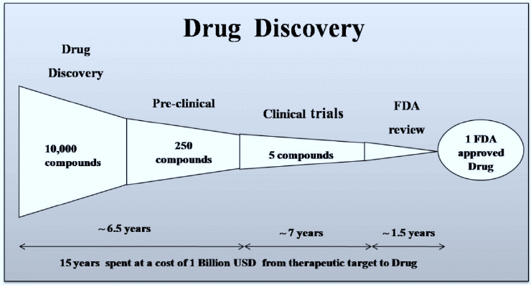
Introduction
Limitations of Drug discovery
Costly and lengthy process.
Four to five main stages.
This is where “Drug Repurposing” is helping
Notes:
Invitro and Invivo ( rat testing)

Slide 5
Introduction
Areas where Computer Science can contribute?
Suggesting candidate drugs.
Risk Assessment done by FDA.
Dose-Response Analysis can be helped through data science.
The research paper aims to contribute by identifying existing drugs that could potentially be repurposed for the treatment of other diseases.
Notes:
Risk Assessment: The gathered data is analyzed to assess potential safety risks associated with the drug candidate. This includes evaluating the drug's potential to cause adverse effects on organs, tissues, or physiological systems.
Dose-Response Analysis: The relationship between the dose of the drug candidate and its observed effects is analyzed. This helps determine the dose range that is safe and effective for further development.
Regression Analysis: Predicts quantitative properties of compounds, such as binding affinity or pharmacokinetic parameters, based on their chemical structure.

Slide 6
Introduction
Which tools can be used in perform the above task?
Clustering and Classification Algorithms
Meticulous analysis and pattern recognition by grouping similar compounds and predicting their efficacy efficiently identify potential drug candidates
Undergone extensive research and has reached a saturation point.
Regression Analysis
Modeling relationships between variables aid in predicting drug effectiveness but not efficient in suggesting candidate drugs.
Cornerstone in the realm of drug discovery
Deep Learning
Forefront of drug discovery research offering immense promise.
Our base paper also focuses here.

Slide 7
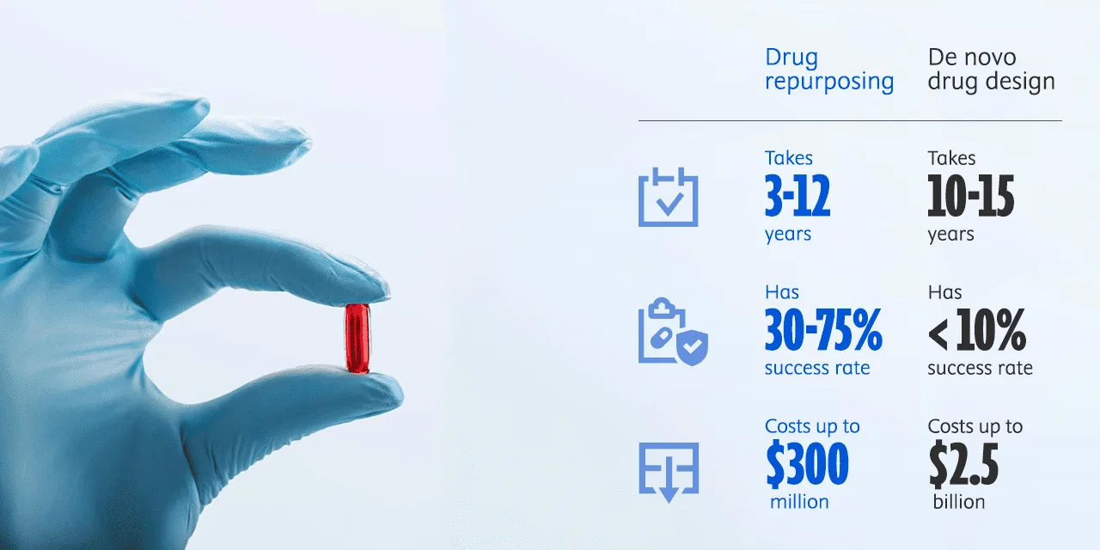
Motivation
Notes:
Covid Examples

Slide 8
SOME DEFINITIONS
Knowledge Graph
Represents a network of real-world entities
Also known as a semantic network
Typically made up of datasets from various sources
DISEASE 1
Treats
Treats
DRUG 1
(Expensive)
DRUG 2
(Affordable)
Treats
DISEASE 2
Notes:
Our base paper leverages Knowledge Graph technology to facilitate the process of drug repositioning.

Slide 9
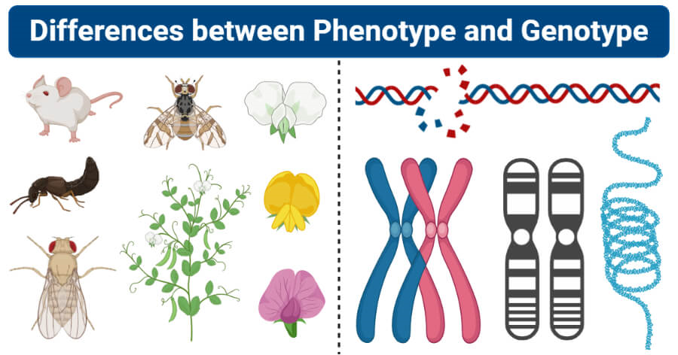
SOME DEFINITIONS
What is Genotypic and Phenotypic?
Genotypic genes are responsible for unique traits or characteristics.
Phenotypic genes are responsible for physical appearance or characteristic of an organism.
Genotypic Phenotypic

Slide 10
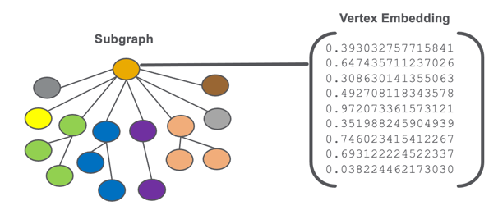
SOME DEFINITIONS
How do we use knowledge graph in algorithms?
How to convert this complex graph into a simpler representation while preserving important information?
Graph Embedding - Embeddings encode objects or concepts in a continuous vector space.
Notes:
Normal graphs is that they cannot be directly processed by Traditional machine learning or deep learning algorithms
Traditional machine learning or deep learning algorithms typically operate on fixed-size vectors or matrices.
Imagine each node getting a compact code that summarizes its relationships with other nodes.
This code (or vector) captures essential information about the node’s position and connections.

Slide 11
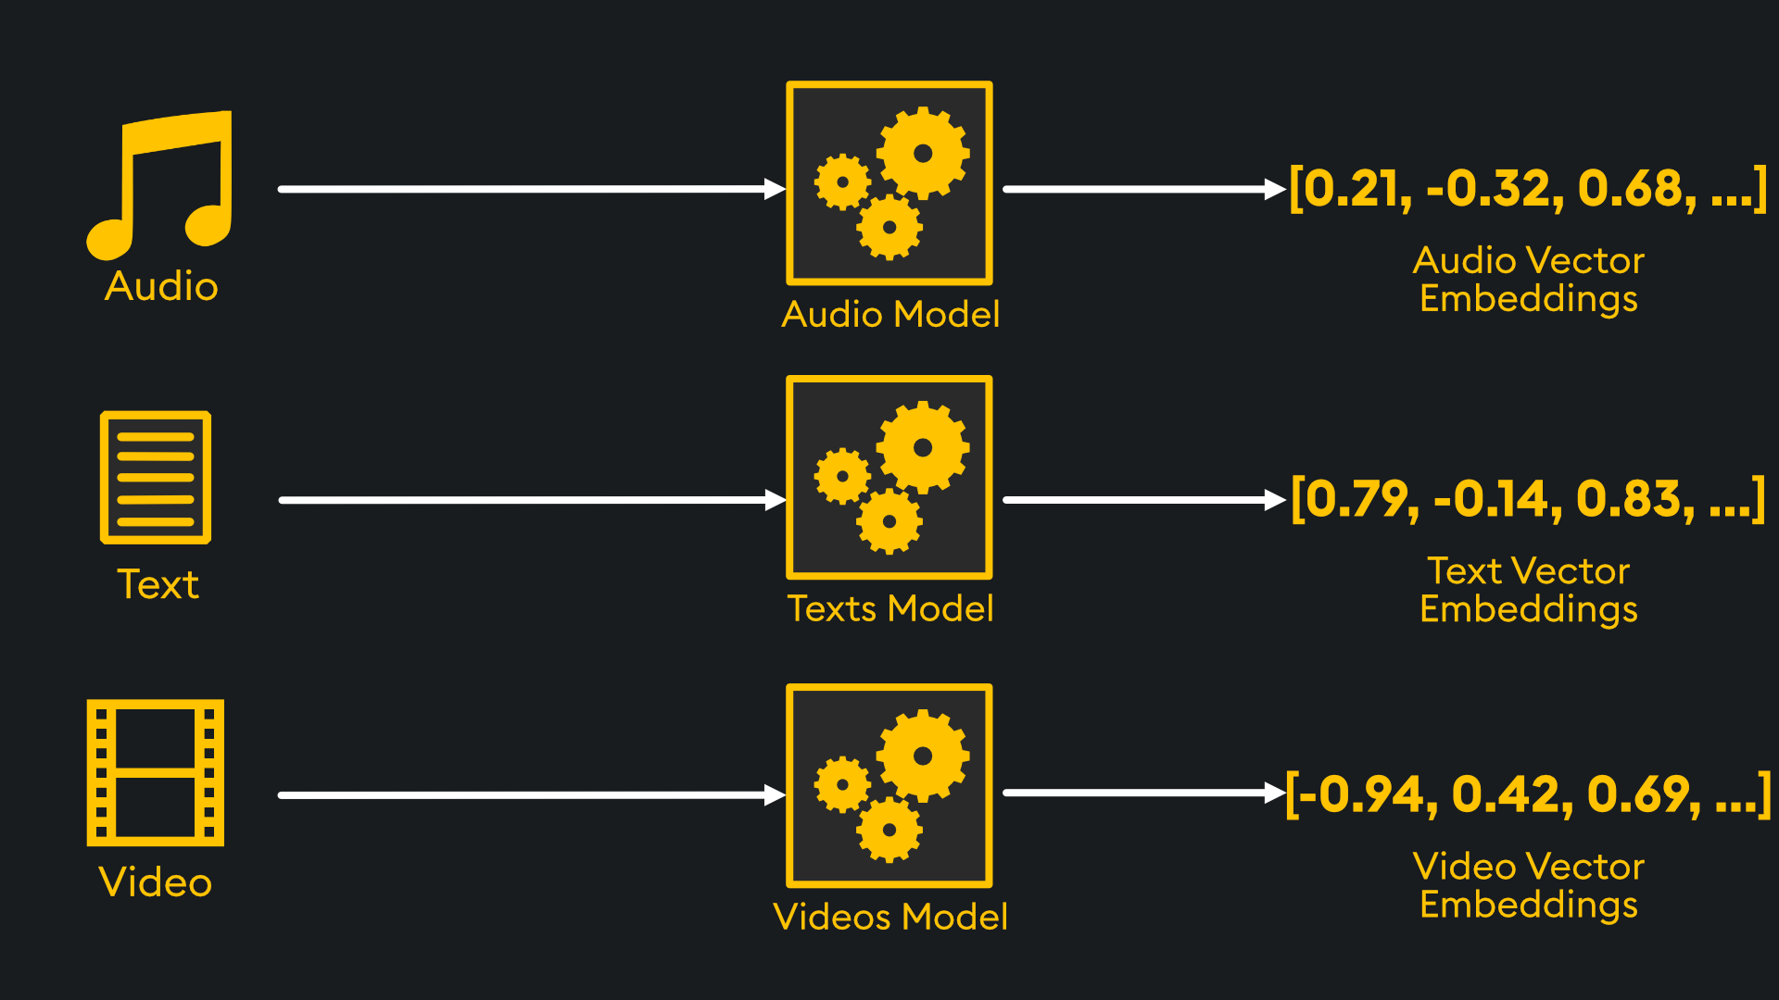
SOME DEFINITIONS
What do these Numbers Signify?
Notes:
Each number in the embedding vector represents a feature, capturing crucial characteristics or relationships.
They facilitate tasks like similarity calculation, classification, and prediction by encoding meaningful information.
Vancouver, Canada : {49°15'40"N, 123°06'50"W}
Burnaby, Canada : {49°16'N, 122°58’W}
The above two are simple vectors and are very close to each other.
Model can conclude that Burnaby is located near Vancouver.

Slide 12
SOME DEFINITIONS
Given an enormous KG, can we complete the KG?
For a given (head, relation), we predict missing tails.
The graph should contain multiple types of relationships otherwise, you can use the standard link prediction techniques.
This graph could also include the origin of drugs and the relationship between them.
DISEASE 1
Treats
Treats
DRUG 1
(Expensive)
DRUG 2
(Affordable)
Treats
Treats?
DISEASE 2
Notes:
Mention this is know as kg ccompletion

Slide 13
SOME DEFINITIONS
Edges in KG are represented as triples (ℎ, r, t)
head (ℎ) has relation (r) with tail (t)
Associate entities and relations with shallow embeddings
Given a triple (ℎ, r, t) the goal is that the embedding of (ℎ, r) should be close to the embedding of t.
How to embed (ℎ, r) ?
How to define score fr (h, t) ?
Score fr is high if (ℎ, r, t) exists, else fr is low
Notes:
Each number in the embedding vector represents a feature, capturing crucial characteristics or relationships.
They facilitate tasks like similarity calculation, classification, and prediction by encoding meaningful information.
Vancouver, Canada : {49°15'40"N, 123°06'50"W}
Burnaby, Canada : {49°16'N, 122°58’W}
The above two are simple vectors and are very close to each other.
Model can conclude that Burnaby is located near Vancouver.

Slide 14
Literature Survey
We started looking into pre-existing state of arts model involving different embeddings.
TransE
Given by- A. Bordes, N. Usunier, A. Garcia-Duran, J. Weston and O. Yakhnenko.
RotatE
Given by- Z. Sun, Z.H. Deng, J.Y. Nie and J. Tang.
DistMult
Given by- B. Yang, W.T. Yih, X. He, J. Gao and L. Deng

Slide 15
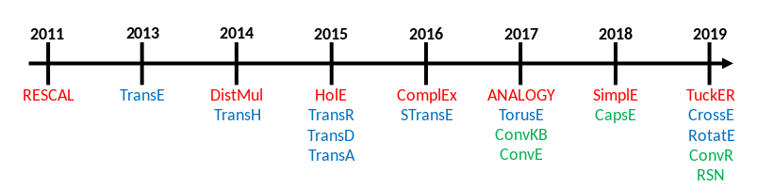
Literature Survey
Timeline of different embedding models.

Slide 16
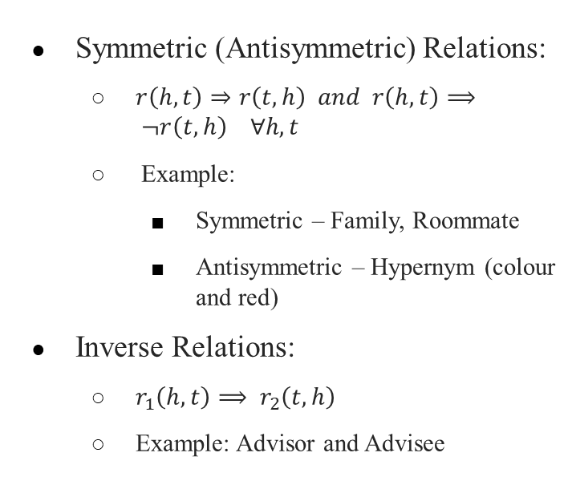
Literature Survey
Symmetric (Antisymmetric) Relations:
$r\left(h, t\right)⇒r\left(t, h\right) and r\left(h, t\right)⟹ ¬r\left(t, h\right) ∀h, t$
Example:
Symmetric – Family, Roommate
Antisymmetric – Hypernym (colour and red)
Inverse Relations:
$r_{1}\left(h, t\right)⟹ r_{2}\left(t, h\right)$
Example: Advisor and Advisee

Slide 17
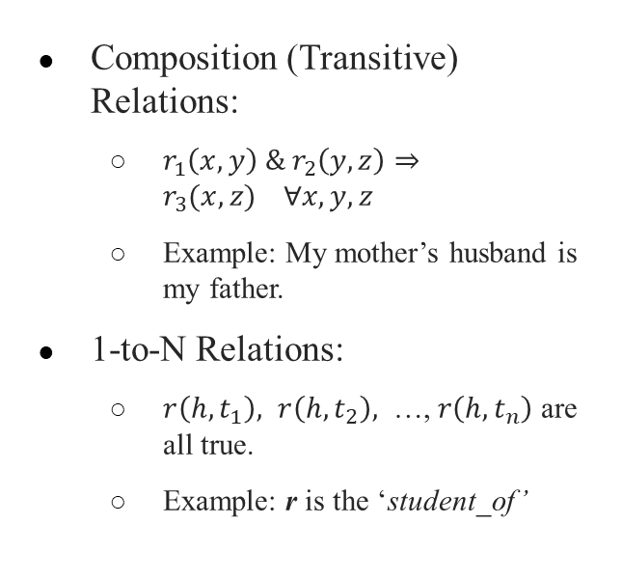
Literature Survey
Composition (Transitive) Relations:
$r_{1}\left(x, y\right) \& r_{2}\left(y, z\right)⇒r_{3}(x, z) ∀x, y, z$
Example: My mother’s husband is my father.
1-to-N Relations:
$r\left(h, t_{1}\right), r\left(h, t_{2}\right),$ …, $r\left(h, t_{n}\right)$ are all true.
Example: r is the ‘student_of’

Slide 18
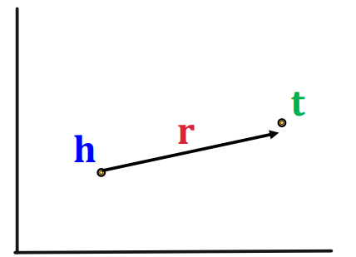
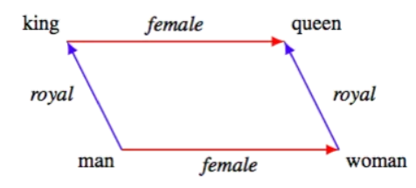
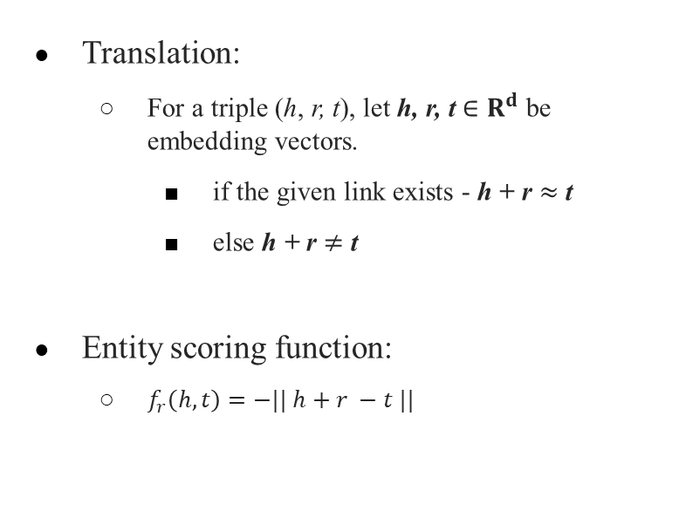
Literature Survey - TransE
Translation:
For a triple (ℎ, r, t), let h, r, t ∈ $R^{d}$ be embedding vectors.
if the given link exists - h + r $≈$t
else h + r $≠$ t
Entity scoring function:
$f_{r}\left(h, t\right)=−|| h+r −t ||$

Slide 19
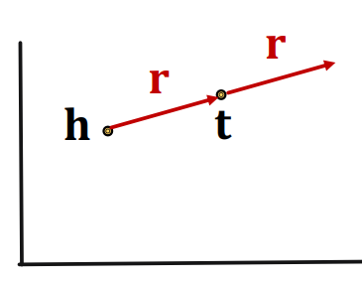
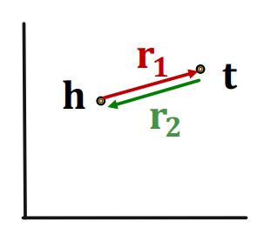
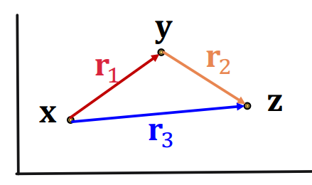
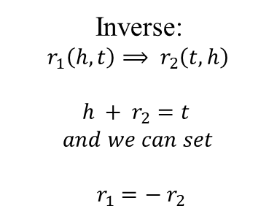
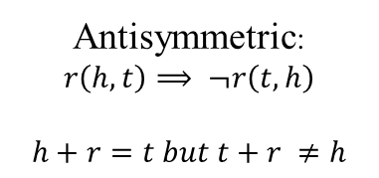
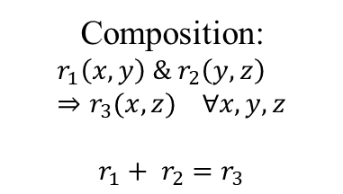
Literature Survey - TransE
Antisymmetric:
$$r\left(h, t\right)⟹ ¬r\left(t, h\right)$$
$$h+r=t but t+r ≠h$$
Inverse:
$$r_{1}\left(h, t\right)⟹ r_{2}\left(t, h\right)$$
$$h + r_{2}=t$$
$$and we can set$$
$$r_{1}=− r_{2}$$
Composition:
$$r_{1}\left(x, y\right) \& r_{2}\left(y, z\right)⇒r_{3}(x, z) ∀x, y, z$$
$$r_{1}+ r_{2}=r_{3}$$

Slide 20
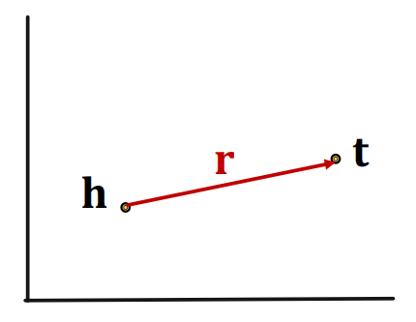
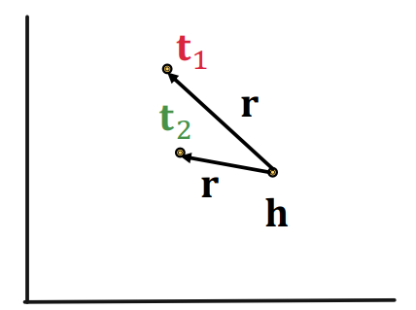
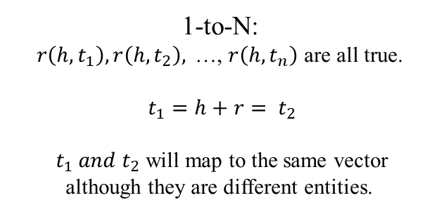
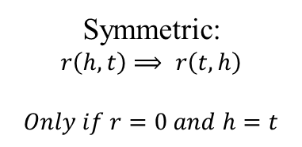
Literature Survey - TransE
Limitations :
Symmetric:
$$r\left(h, t\right)⟹ r\left(t, h\right)$$
$$Only if r=0 and h=t$$
1-to-N:
$$r\left(h, t_{1}\right), r\left(h, t_{2}\right),\text{ …, }r\left(h, t_{n}\right) \text{are} \text{all} \text{true}\text{.}$$
$t_{1}=h+r= t_{2}$
$t_{1} and t_{2}$ will map to the same vector although they are different entities.

Slide 21
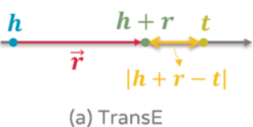
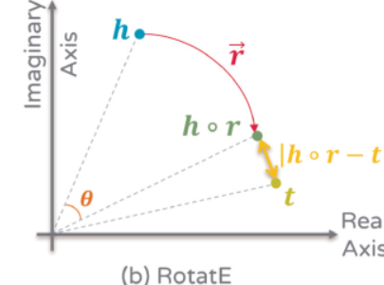
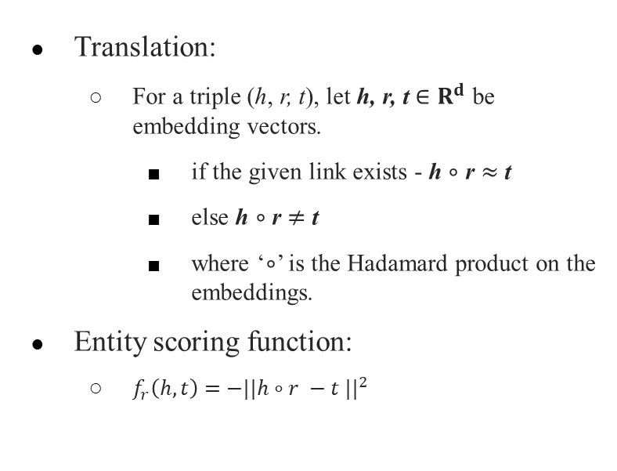
Literature Survey -RotatE
Translation:
For a triple (ℎ, r, t), let h, r, t ∈ $R^{d}$ be embedding vectors.
if the given link exists - h $∘$ r $≈$t
else h $∘$ r $≠$ t
where ‘$∘$’ is the Hadamard product on the embeddings.
Entity scoring function:
$f_{r}\left(h, t\right)=$ ${−||h∘r −t ||}^{2}$
The Hadamard product is a binary operation that takes in two matrices of the same dimensions and returns a matrix of the multiplied corresponding elements.

Slide 22
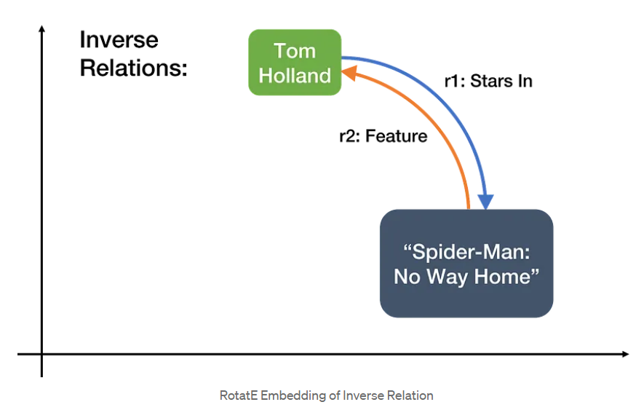
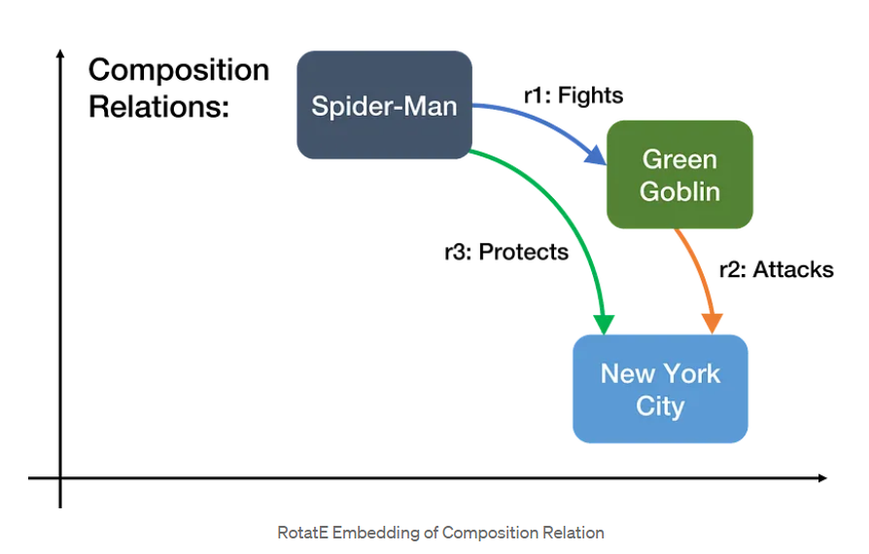
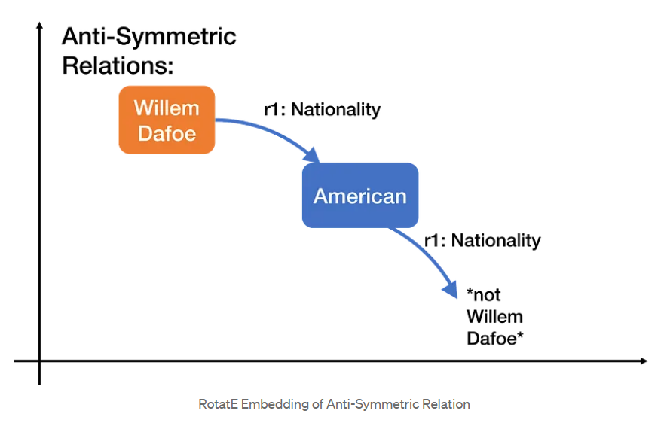
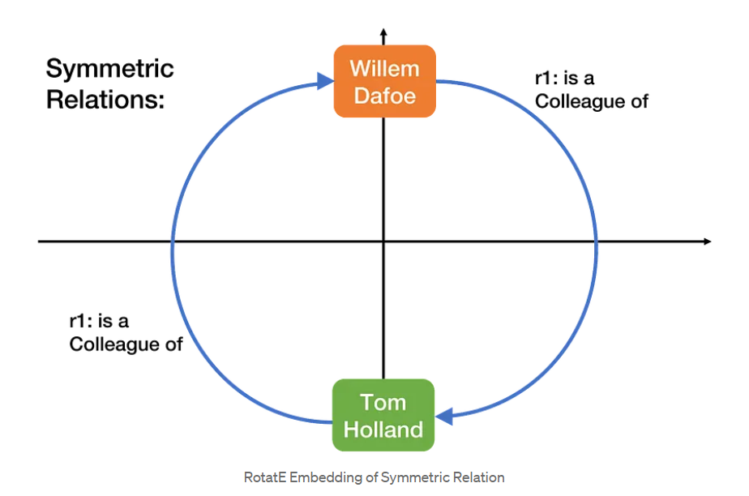
Literature Survey -RotatE
RotatE can model symmetric relations that TransE cannot express! It does so as 180-degree rotations.

Slide 23
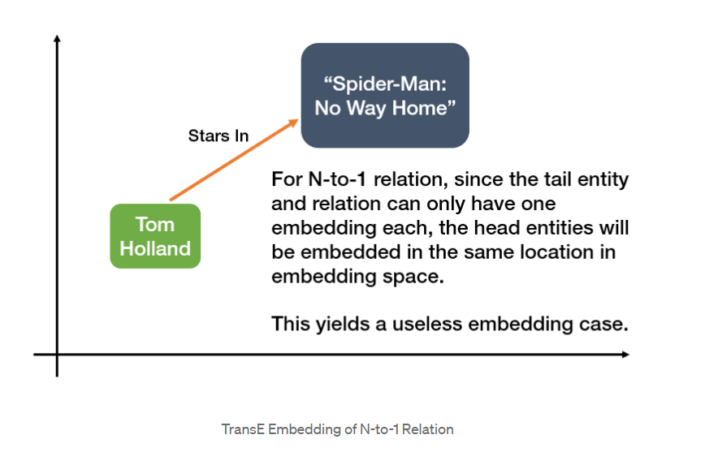
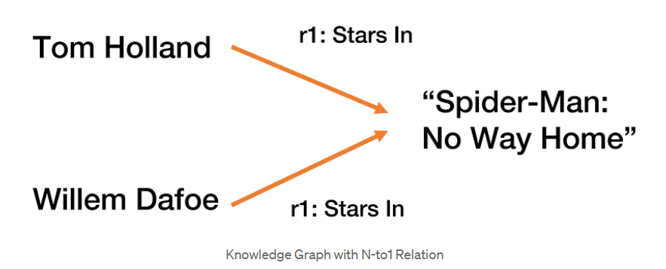
Literature Survey -RotatE
Limitations :

Slide 24
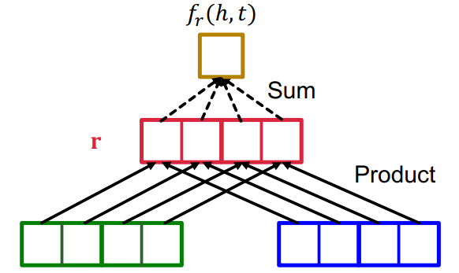
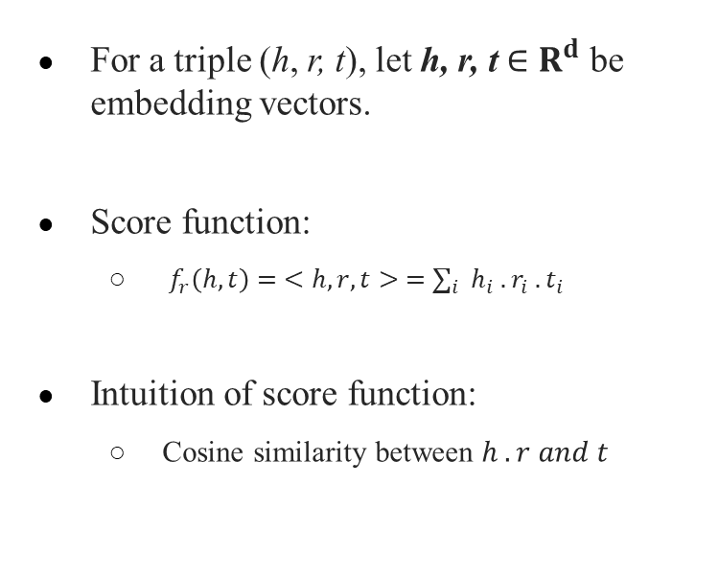
Literature Survey -DistMult
For a triple (ℎ, r, t), let h, r, t ∈ $R^{d}$ be embedding vectors.
Score function:
$f_{r}\left(h, t\right)= <h, r, t> =∑_{i } h_{i} . r_{i} . t_{i}$
Intuition of score function:
Cosine similarity between $h . r and t$

Slide 25
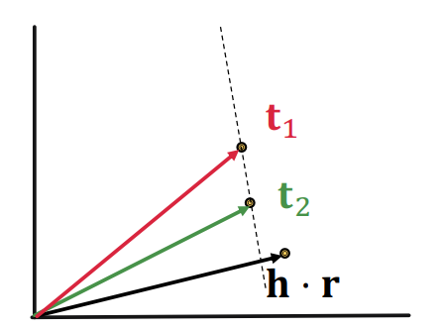
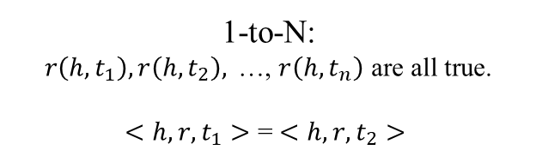
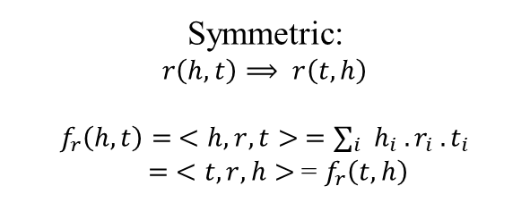
Literature Survey -DistMult
Symmetric:
$$r\left(h, t\right)⟹ r\left(t, h\right)$$
$$f_{r}\left(h, t\right)= <h, r, t> =∑_{i } h_{i} . r_{i} . t_{i}$$
$= <t, r, h>$= $f_{r}\left(t, h\right)$
1-to-N:
$$r\left(h, t_{1}\right), r\left(h, t_{2}\right),\text{ …, }r\left(h, t_{n}\right) \text{are} \text{all} \text{true}\text{.}$$
$<h, r, t_{1}>$ = $<h, r, t_{2}>$

Slide 26
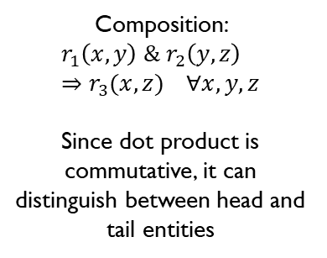
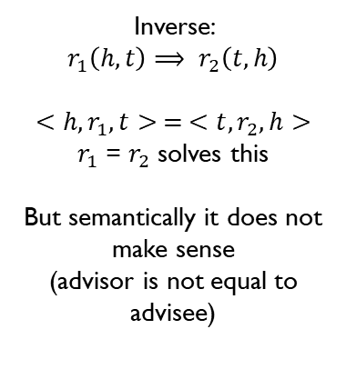
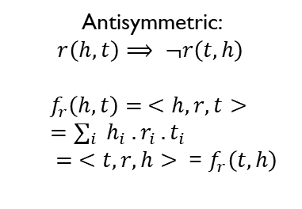
Literature Survey -DistMult
Limitations :
Antisymmetric:
$$r\left(h, t\right)⟹ ¬r\left(t, h\right)$$
$$f_{r}\left(h, t\right)= <h, r, t> =∑_{i } h_{i} . r_{i} . t_{i}$$
$$= <t, r, h> \text{=} f_{r}\left(t, h\right)$$
Inverse:
$$r_{1}\left(h, t\right)⟹ r_{2}\left(t, h\right)$$
$$<h, r_{1}, t> = <t, r_{2}, h>$$
$r_{1}$ = $r_{2}$ solves this
But semantically it does not make sense
(advisor is not equal to advisee)
Composition:
$$r_{1}\left(x, y\right) \& r_{2}\left(y, z\right)⇒r_{3}(x, z) ∀x, y, z$$
Since dot product is commutative, it can distinguish between head and tail entities

Slide 27


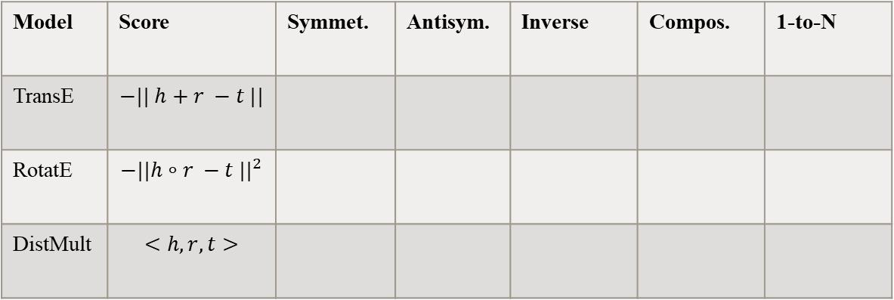
Literature Survey
Summary of different embedding techniques:
Model | Score | Symmet. | Antisym. | Inverse | Compos. | 1-to-N
TransE | $$−|| h+r −t ||$$
RotatE | $${−||h∘r −t ||}^{2}$$
DistMult | $$<h, r, t>$$

Slide 28
Literature Survey
This Led us to our Base Paper “KG-Predict: A knowledge graph computational framework for drug repurposing”.
The authors extended the Composition based multi regional graph Convolutional network (CompGCN).

Slide 29
Literature Survey
Knowledge Graph Construction
61,146 nodes with 7 node types
1,246,726 edges
Categorized into 9 semantic relationships
2 from genome-level knowledge databases
1 from text-mined knowledge bases
6 from phenome-level knowledge databases

Slide 30
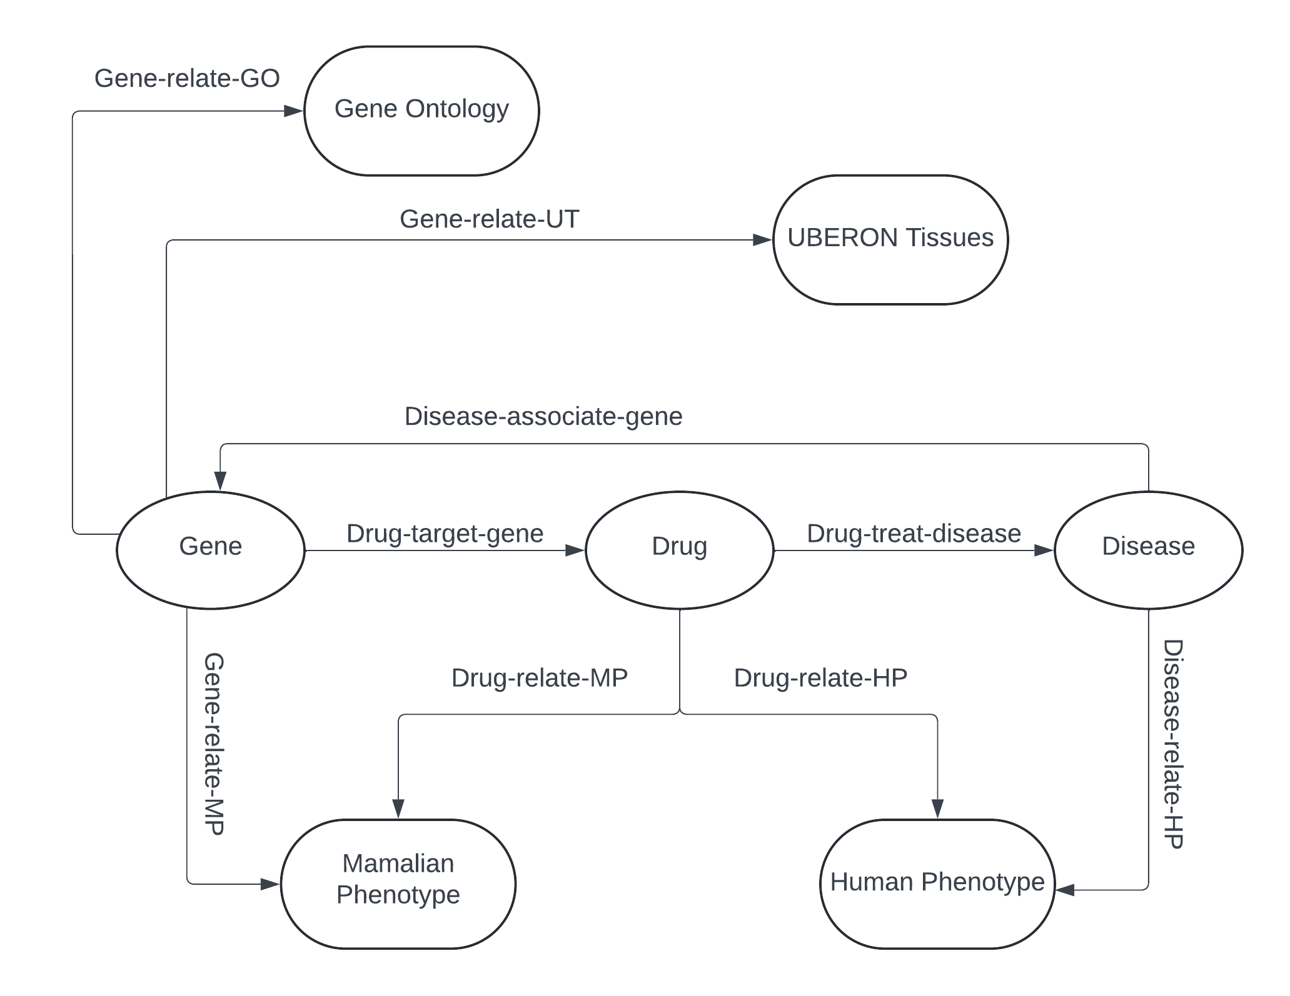
Literature Survey

Slide 31
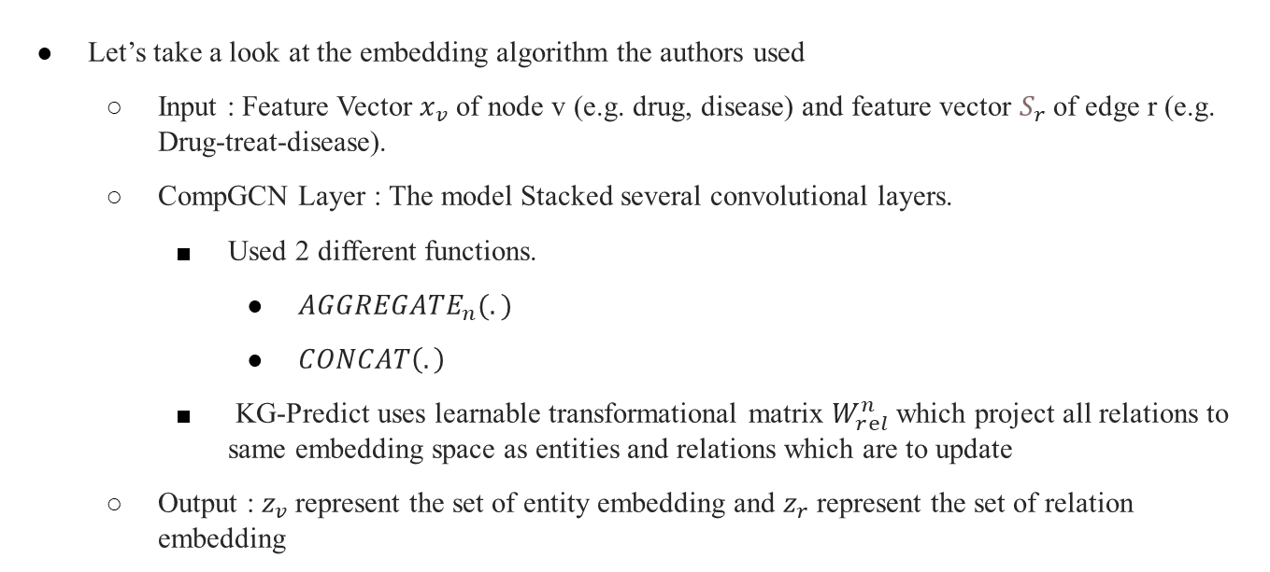
Literature Survey
Let’s take a look at the embedding algorithm the authors used
Input : Feature Vector $x_{v}$ of node v (e.g. drug, disease) and feature vector $S_{r}$of edge r (e.g. Drug-treat-disease).
CompGCN Layer : The model Stacked several convolutional layers.
Used 2 different functions.
$AGGREGATE_{n}(.)$
$CONCAT\left(.\right)$
KG-Predict uses learnable transformational matrix $W_{rⅇl}^{n}$ which project all relations to same embedding space as entities and relations which are to update
Output : $z_{v}$represent the set of entity embedding and $z_{r}$ represent the set of relation embedding

Slide 32
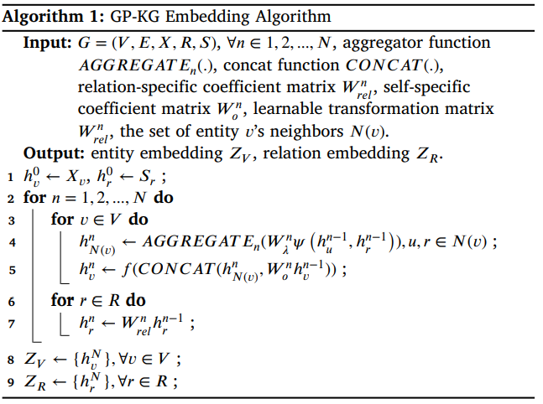
Literature Survey
Pseudo Code for the explained algorithm

Slide 33
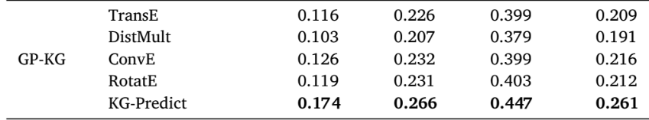
Literature Survey
How well did KG-Predict outperformed the other state of art embedding methods ?

Slide 34
OBJECTIVE
Modify the GP-KG embedding process to construct a unique embedding methodology
Investigate state-of-the-art embedding and make necessary alteration to them.
Use Altered embedding to develop new technique and use them to find results on Prediction model.

Slide 35
THANKYOU

